Slide 1
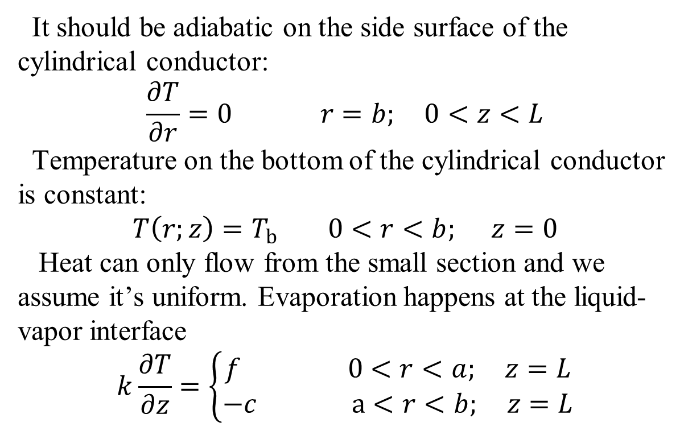



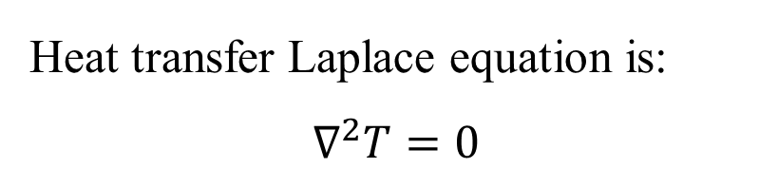
Spreading resistance
$$T_{b}$$
z
It should be adiabatic on the side surface of the cylindrical conductor:
$$\frac{∂T}{∂r}=0 r=b; 0<z<L$$
Temperature on the bottom of the cylindrical conductor is constant:
$$T\left(r;z\right)=T_{b} 0<r<b; z=0$$
Heat can only flow from the small section and we assume it’s uniform. Evaporation happens at the liquid-vapor interface
$$k\frac{∂T}{∂z}=\left\{\begin{aligned}f 0<r<a; z=L \\ −c a<r<b; z=L\end{aligned}\right.$$
L
r
O
$$f$$
$$c$$
Heat transfer Laplace equation is:
$$∇^{2}T=0$$

Slide 2

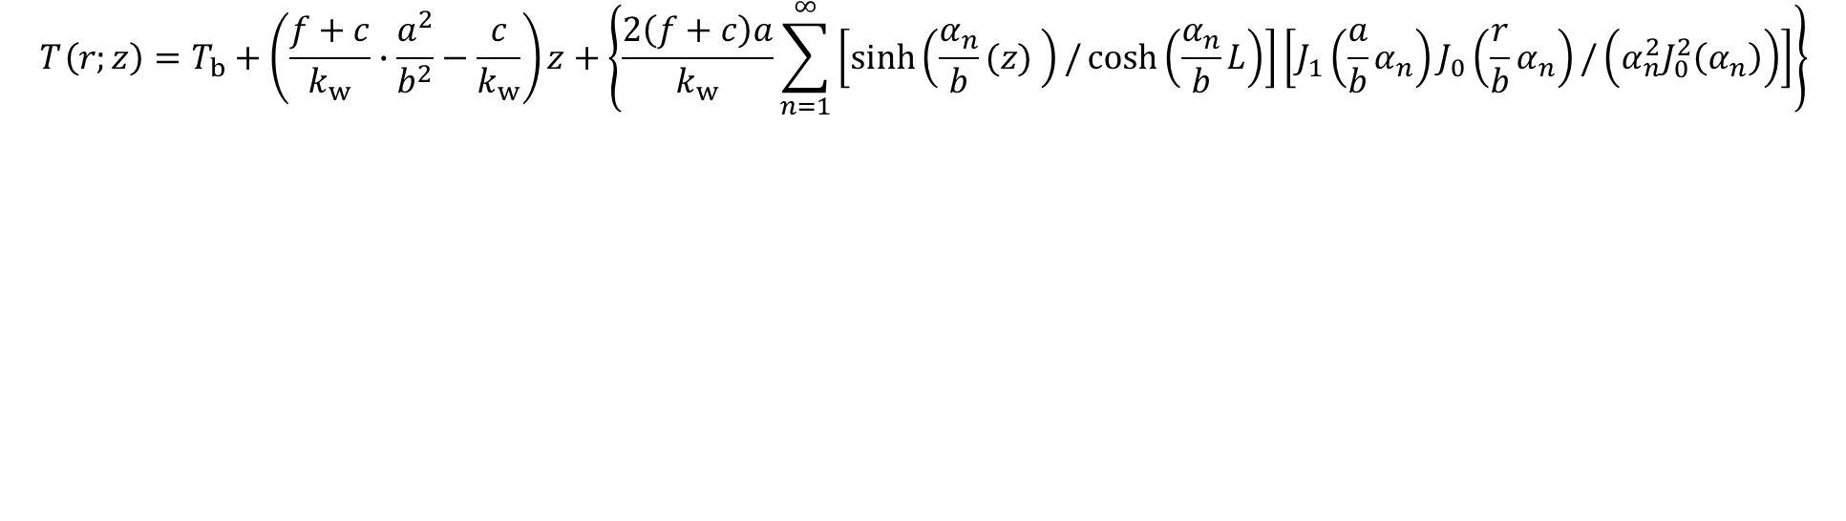


Solution
$$T_{ }\left(r;z\right)=T_{b}+\left(\frac{f+c}{k_{w}}∙\frac{a^{2}}{b^{2}}−\frac{c}{k_{w}}\right)z+\left\{\frac{2\left(f+c\right)a}{k_{w}}\sum_{n=1}^{∞}{\left[\sinh\left(\frac{α_{n}}{b}(z) \right)/\cosh\left(\frac{α_{n}}{b}L\right)\right]}\left[J_{1}\left(\frac{a}{b}α_{n}\right)J_{0}\left(\frac{r}{b}α_{n}\right)/\left(α_{n}^{2}J_{0}^{2}\left(α_{n}\right)\right)\right]\right\}$$
$$T_{b}$$
z
L
r
O
$$f$$
$$c$$

Slide 3




All evaporation happens at the droplet base
$$T_{ }\left(r;z\right)=T_{b}+\left(\frac{f+c}{k_{w}}∙\frac{a^{2}}{b^{2}}−\frac{c}{k_{w}}\right)z+\left\{\frac{2\left(f+c\right)a}{k_{w}}\sum_{n=1}^{∞}{\left[\sinh\left(\frac{α_{n}}{b}(z) \right)/\cosh\left(\frac{α_{n}}{b}L\right)\right]}\left[J_{1}\left(\frac{a}{b}α_{n}\right)J_{0}\left(\frac{r}{b}α_{n}\right)/\left(α_{n}^{2}J_{0}^{2}\left(α_{n}\right)\right)\right]\right\}$$
With energy balance
$$πa^{2}f=π\left(b^{2}−a^{2}\right)c$$
$$\left(f+c\right)∙\frac{a^{2}}{b^{2}}−c=\left(f+\frac{a^{2}}{b^{2}−a^{2}}f\right)∙\frac{a^{2}}{b^{2}}−\frac{a^{2}}{b^{2}−a^{2}}f=0$$
$$T_{b}$$
z
L
r
O
$$f$$
$$c$$

Slide 4
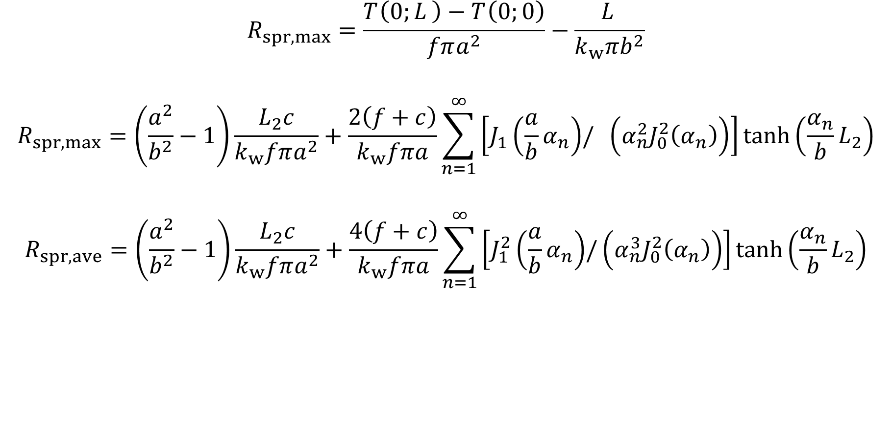
Spreading resistance
$$R_{spr,max}=\frac{T_{ }\left(0;L_{ }\right)−T_{ }\left(0;0\right)}{fπa^{2}}−\frac{L_{ }}{k_{w}πb^{2}}$$
$$R_{spr,max}=\left(\frac{a^{2}}{b^{2}}−1\right)\frac{L_{2}c}{k_{w}fπa^{2}}+\frac{2\left(f+c\right)}{k_{w}fπa}\sum_{n=1}^{∞}{\left[J_{1}\left(\frac{a}{b}α_{n}\right){/ \left(α_{n}^{2}J_{0}^{2}\left(α_{n}\right)\right)}\right]\tanh\left(\frac{α_{n}}{b}L_{2}\right)}$$
$$R_{spr,ave}=\left(\frac{a^{2}}{b^{2}}−1\right)\frac{L_{2}c}{k_{w}fπa^{2}}+\frac{4\left(f+c\right)}{k_{w}fπa}\sum_{n=1}^{∞}{\left[J_{1}^{2}\left(\frac{a}{b}α_{n}\right){/\left(α_{n}^{3}J_{0}^{2}\left(α_{n}\right)\right)}\right]}\tanh\left(\frac{α_{n}}{b}L_{2}\right)$$

Slide 5
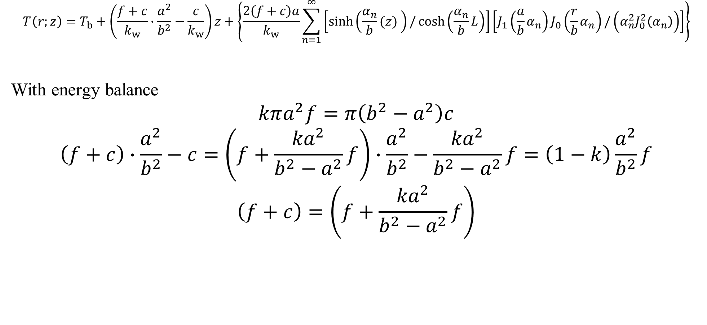
All evaporation happens at the droplet base
$$T_{ }\left(r;z\right)=T_{b}+\left(\frac{f+c}{k_{w}}∙\frac{a^{2}}{b^{2}}−\frac{c}{k_{w}}\right)z+\left\{\frac{2\left(f+c\right)a}{k_{w}}\sum_{n=1}^{∞}{\left[\sinh\left(\frac{α_{n}}{b}(z) \right)/\cosh\left(\frac{α_{n}}{b}L\right)\right]}\left[J_{1}\left(\frac{a}{b}α_{n}\right)J_{0}\left(\frac{r}{b}α_{n}\right)/\left(α_{n}^{2}J_{0}^{2}\left(α_{n}\right)\right)\right]\right\}$$
With energy balance
$$kπa^{2}f=π\left(b^{2}−a^{2}\right)c$$
$$\left(f+c\right)∙\frac{a^{2}}{b^{2}}−c=\left(f+\frac{{ka}^{2}}{b^{2}−a^{2}}f\right)∙\frac{a^{2}}{b^{2}}−\frac{{ka}^{2}}{b^{2}−a^{2}}f=\left(1−k\right)\frac{a^{2}}{b^{2}}f$$
$$\left(f+c\right)=\left(f+\frac{{ka}^{2}}{b^{2}−a^{2}}f\right)$$
$$T_{b}$$
z
L
r
O
$$f$$
$$c$$

Slide 6
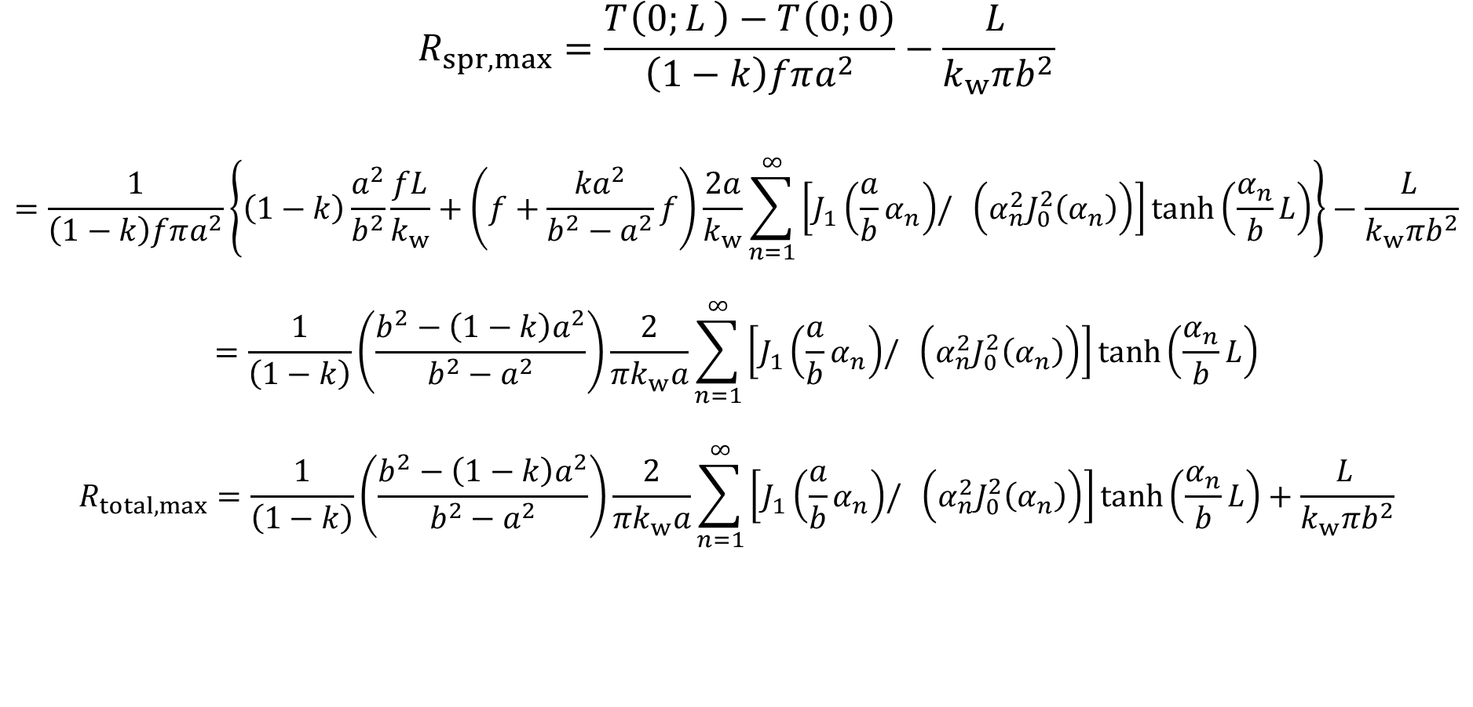
Spreading resistance
$$R_{spr,max}=\frac{T_{ }\left(0;L_{ }\right)−T_{ }\left(0;0\right)}{\left(1−k\right)fπa^{2}}−\frac{L_{ }}{k_{w}πb^{2}}$$
$$=\frac{1}{\left(1−k\right)fπa^{2}}\left\{\left(1−k\right)\frac{a^{2}}{b^{2}}\frac{fL}{k_{w}}+\left(f+\frac{{ka}^{2}}{b^{2}−a^{2}}f\right)\frac{2a}{k_{w}}\sum_{n=1}^{∞}{\left[J_{1}\left(\frac{a}{b}α_{n}\right){/ \left(α_{n}^{2}J_{0}^{2}\left(α_{n}\right)\right)}\right]\tanh\left(\frac{α_{n}}{b}L\right)}\right\}−\frac{L_{ }}{k_{w}πb^{2}}$$
$$=\frac{1}{\left(1−k\right)}\left(\frac{b^{2}−\left(1−k\right)a^{2}}{b^{2}−a^{2}}\right)\frac{2}{{πk}_{w}a}\sum_{n=1}^{∞}{\left[J_{1}\left(\frac{a}{b}α_{n}\right){/ \left(α_{n}^{2}J_{0}^{2}\left(α_{n}\right)\right)}\right]\tanh\left(\frac{α_{n}}{b}L\right)}$$
$$R_{total,max}=\frac{1}{\left(1−k\right)}\left(\frac{b^{2}−\left(1−k\right)a^{2}}{b^{2}−a^{2}}\right)\frac{2}{{πk}_{w}a}\sum_{n=1}^{∞}{\left[J_{1}\left(\frac{a}{b}α_{n}\right){/ \left(α_{n}^{2}J_{0}^{2}\left(α_{n}\right)\right)}\right]\tanh\left(\frac{α_{n}}{b}L\right)}+\frac{L_{ }}{k_{w}πb^{2}}$$

Slide 7
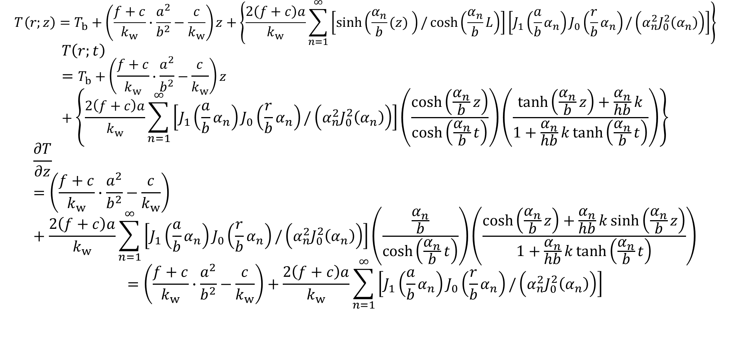
Convective boundary condition
$$T_{ }\left(r;z\right)=T_{b}+\left(\frac{f+c}{k_{w}}∙\frac{a^{2}}{b^{2}}−\frac{c}{k_{w}}\right)z+\left\{\frac{2\left(f+c\right)a}{k_{w}}\sum_{n=1}^{∞}{\left[\sinh\left(\frac{α_{n}}{b}(z) \right)/\cosh\left(\frac{α_{n}}{b}L\right)\right]}\left[J_{1}\left(\frac{a}{b}α_{n}\right)J_{0}\left(\frac{r}{b}α_{n}\right)/\left(α_{n}^{2}J_{0}^{2}\left(α_{n}\right)\right)\right]\right\}$$
$$T\left(r;t\right)=T_{b}+\left(\frac{f+c}{k_{w}}∙\frac{a^{2}}{b^{2}}−\frac{c}{k_{w}}\right)z+\left\{\frac{2\left(f+c\right)a}{k_{w}}\sum_{n=1}^{∞}{\left[J_{1}\left(\frac{a}{b}α_{n}\right)J_{0}\left(\frac{r}{b}α_{n}\right)/\left(α_{n}^{2}J_{0}^{2}\left(α_{n}\right)\right)\right]}\left(\frac{\cosh\left(\frac{α_{n}}{b}z\right)}{\cosh\left(\frac{α_{n}}{b}t\right)}\right)\left(\frac{\tanh\left(\frac{α_{n}}{b}z\right)+\frac{α_{n}}{hb}k}{1+\frac{α_{n}}{hb}k\tanh\left(\frac{α_{n}}{b}t\right)}\right)\right\}$$
$$\frac{∂T}{∂z}=\left(\frac{f+c}{k_{w}}∙\frac{a^{2}}{b^{2}}−\frac{c}{k_{w}}\right)+\frac{2\left(f+c\right)a}{k_{w}}\sum_{n=1}^{∞}{\left[J_{1}\left(\frac{a}{b}α_{n}\right)J_{0}\left(\frac{r}{b}α_{n}\right)/\left(α_{n}^{2}J_{0}^{2}\left(α_{n}\right)\right)\right]}\left(\frac{\frac{α_{n}}{b}}{\cosh\left(\frac{α_{n}}{b}t\right)}\right)\left(\frac{\cosh\left(\frac{α_{n}}{b}z\right)+\frac{α_{n}}{hb}k\sinh\left(\frac{α_{n}}{b}z\right)}{1+\frac{α_{n}}{hb}k\tanh\left(\frac{α_{n}}{b}t\right)}\right)$$
$$=\left(\frac{f+c}{k_{w}}∙\frac{a^{2}}{b^{2}}−\frac{c}{k_{w}}\right)+\frac{2\left(f+c\right)a}{k_{w}}\sum_{n=1}^{∞}{\left[J_{1}\left(\frac{a}{b}α_{n}\right)J_{0}\left(\frac{r}{b}α_{n}\right)/\left(α_{n}^{2}J_{0}^{2}\left(α_{n}\right)\right)\right]}$$

Slide 8
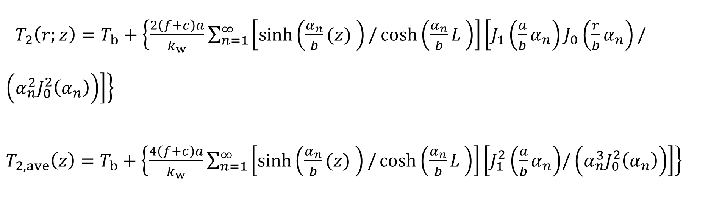
Temperature distribution
$T_{2}\left(r;z\right)=T_{b}+\left\{\frac{2\left(f+c\right)a}{k_{w}}\sum_{n=1}^{∞}{\left[\sinh\left(\frac{α_{n}}{b}(z) \right)/\cosh\left(\frac{α_{n}}{b}L_{ }\right)\right]}\left[J_{1}\left(\frac{a}{b}α_{n}\right)J_{0}\left(\frac{r}{b}α_{n}\right)/\left(α_{n}^{2}J_{0}^{2}\left(α_{n}\right)\right)\right]\right\}$
$T_{2,ave}\left(z\right)=T_{b}+\left\{\frac{4\left(f+c\right)a}{k_{w}}\sum_{n=1}^{∞}{\left[\sinh\left(\frac{α_{n}}{b}(z) \right)/\cosh\left(\frac{α_{n}}{b}L_{ }\right)\right]}\left[J_{1}^{2}\left(\frac{a}{b}α_{n}\right){/\left(α_{n}^{3}J_{0}^{2}\left(α_{n}\right)\right)}\right]\right\}$

Slide 9
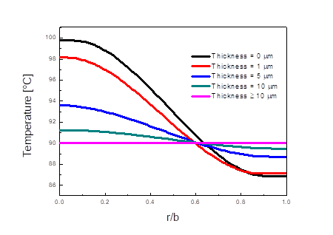
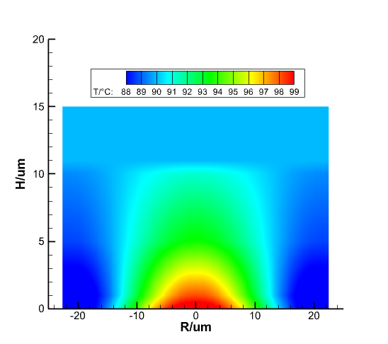
Temperature distribution

Slide 10
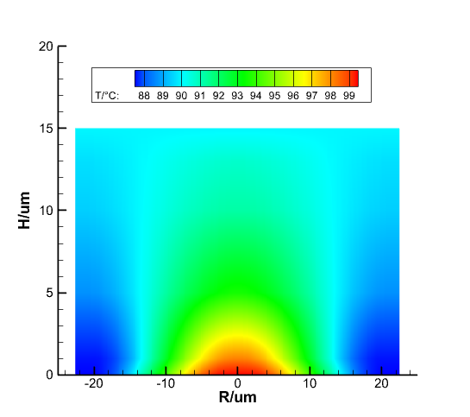
Temperature distribution

Slide 11
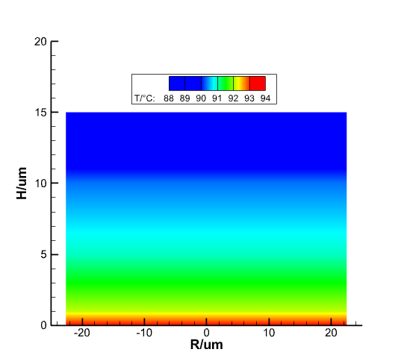
Average temperature

Slide 12
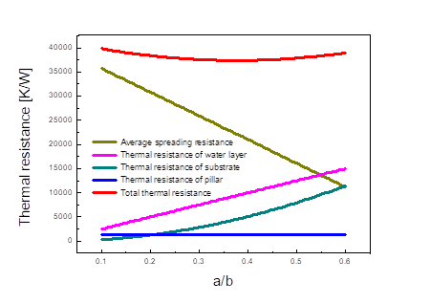
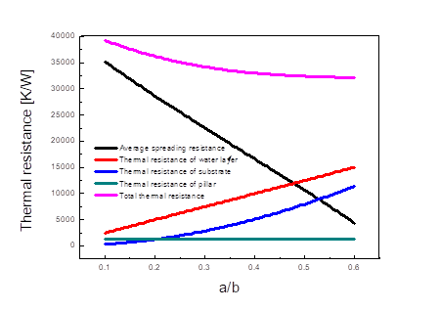

Thermal resistance
$$c=0$$
$$πa^{2}f=π\left(b^{2}−a^{2}\right)c$$

Slide 13
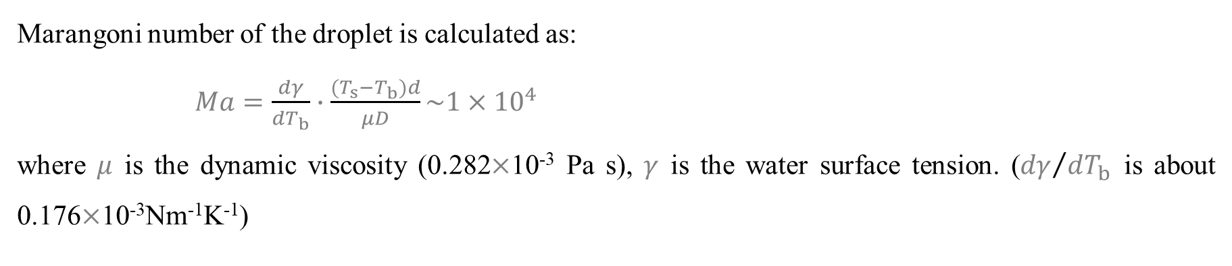
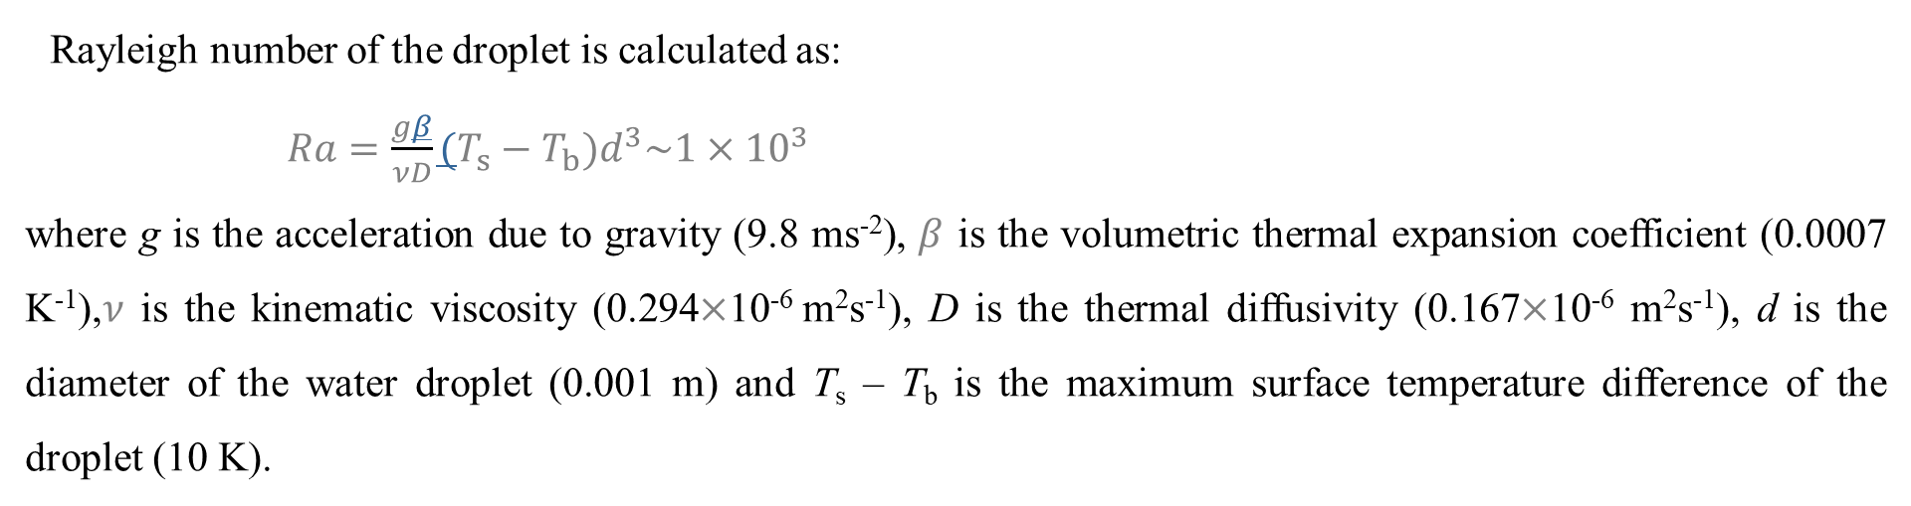
Scaling
Rayleigh number of the droplet is calculated as:
$Ra=\frac{gβ}{νD}(T_{s}−T_{b})d^{3}\sim {1×10}^{3}$
where g is the acceleration due to gravity (9.8 ms⁻²), $β$ is the volumetric thermal expansion coefficient (0.0007 K⁻¹),$ν$ is the kinematic viscosity (0.294$×$10⁻⁶ m²s⁻¹), D is the thermal diffusivity (0.167$×$10⁻⁶ m²s⁻¹), d is the diameter of the water droplet (0.001 m) and T_{s} – T_{b} is the maximum surface temperature difference of the droplet (10 K).
Marangoni number of the droplet is calculated as:
$Ma=\frac{dγ}{dT_{b}}∙\frac{(T_{s}−T_{b})d}{μD}\sim {1×10}^{4}$
where $μ$ is the dynamic viscosity (0.282$×$10⁻³ Pa s), $γ$ is the water surface tension. (${dγ}/{dT_{b}}$ is about 0.176$×$10⁻³Nm⁻¹K⁻¹)

Slide 14
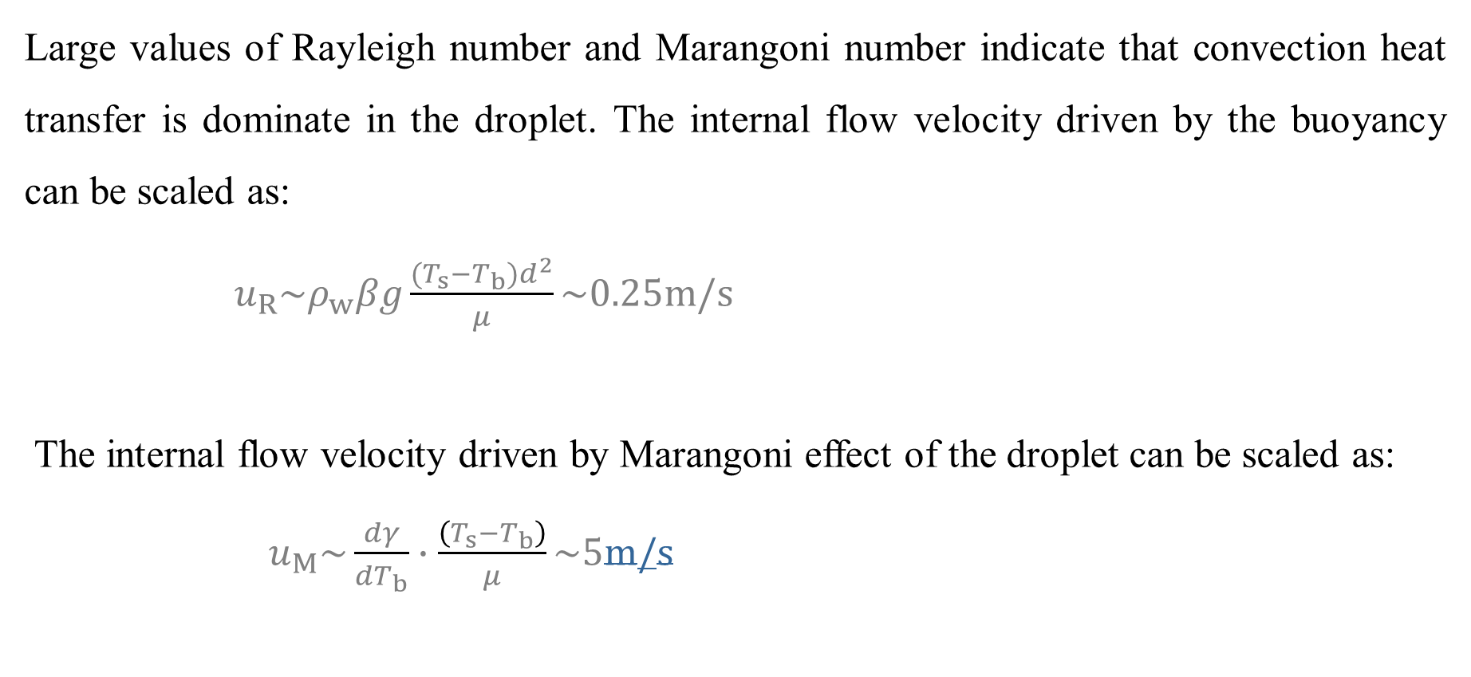
Scaling
Large values of Rayleigh number and Marangoni number indicate that convection heat transfer is dominate in the droplet. The internal flow velocity driven by the buoyancy can be scaled as:
$u_{R}\sim ρ_{w}βg\frac{(T_{s}−T_{b})d^{2}}{μ}\sim 0.25m/s$
The internal flow velocity driven by Marangoni effect of the droplet can be scaled as:
$u_{M}\sim \frac{dγ}{dT_{b}}∙\frac{\left(T_{s}−T_{b}\right)}{μ}\sim 5m/s$

Slide 15
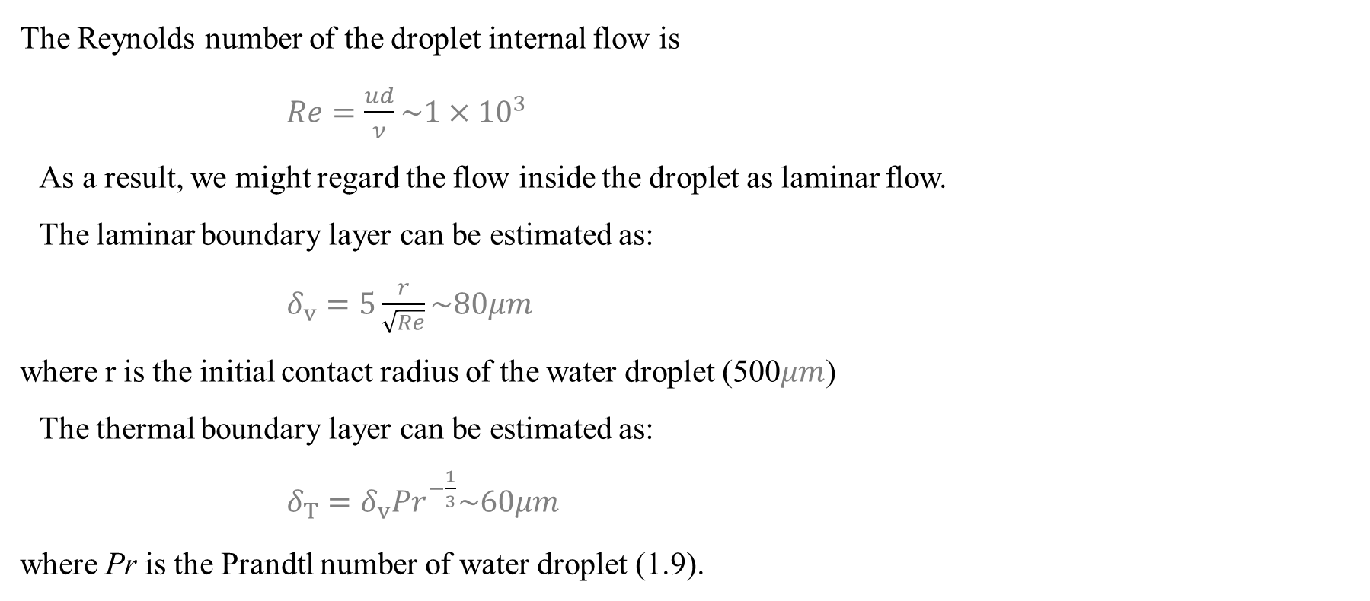
Scaling
The Reynolds number of the droplet internal flow is
$Re=\frac{ud}{ν}\sim {1×10}^{3}$
As a result, we might regard the flow inside the droplet as laminar flow.
The laminar boundary layer can be estimated as:
$δ_{v}=5\frac{r}{\sqrt{Re}}\sim 80μm$
where r is the initial contact radius of the water droplet (500$μm$)
The thermal boundary layer can be estimated as:
$δ_{T}=δ_{v}{Pr}^{−\frac{1}{3}}\sim 60μm$
where Pr is the Prandtl number of water droplet (1.9).

